Slide 1
Android Studio
Università di Modena e Reggio Emilia

Slide 2
Intro
Android Studio is the official Android IDE.
Is based on IntelliJ IDEA.
Includes:
Android SDK and JDK (Java Development Kit)
Gradle plugins
Android emulator
Android profiler
VCS integration
Layout design tool
Debug tools
Testing tools and framework (JUnit)
Access to device’s filesystem
Android logging and output console
Android Project Wizard: simplifies creating new project

Slide 3
Tools

Slide 4
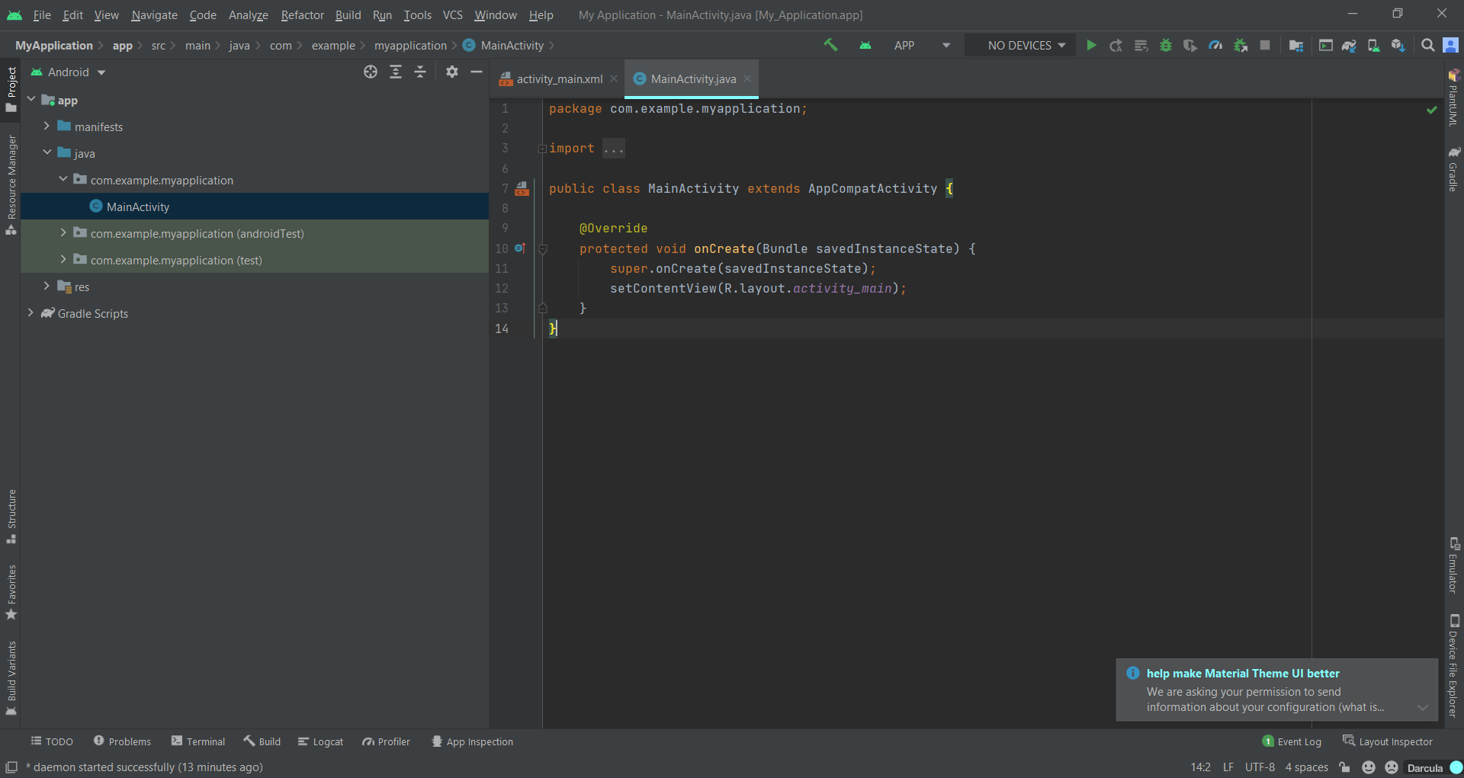
Android Studio Tools
1
2
Menu Bar
Toolbar
Navigation Bar
Editor Window
Status Bar
Tool Window Bar (on the edges of IDE circled in red)
3
4
6
5

Slide 5
Toolbar
Build project:
Run/Debug configurations:
Target devices: list of available device where you can run app
Run/Install app on selected device
Aply changes: apply code changes on app’s version installed on target device
App debug:
Profiler: show the behavior and performance of your app in real time (CPU, memory managment, network traffic)
Stop app: force stop of app
Project structure: show project settings
Sync project: sync gradle’s files (external dependencies …)
AVD Manager: manage your virtual device
SDK Manager: manage Additional SDK Components and SDK upgrade.

Slide 6
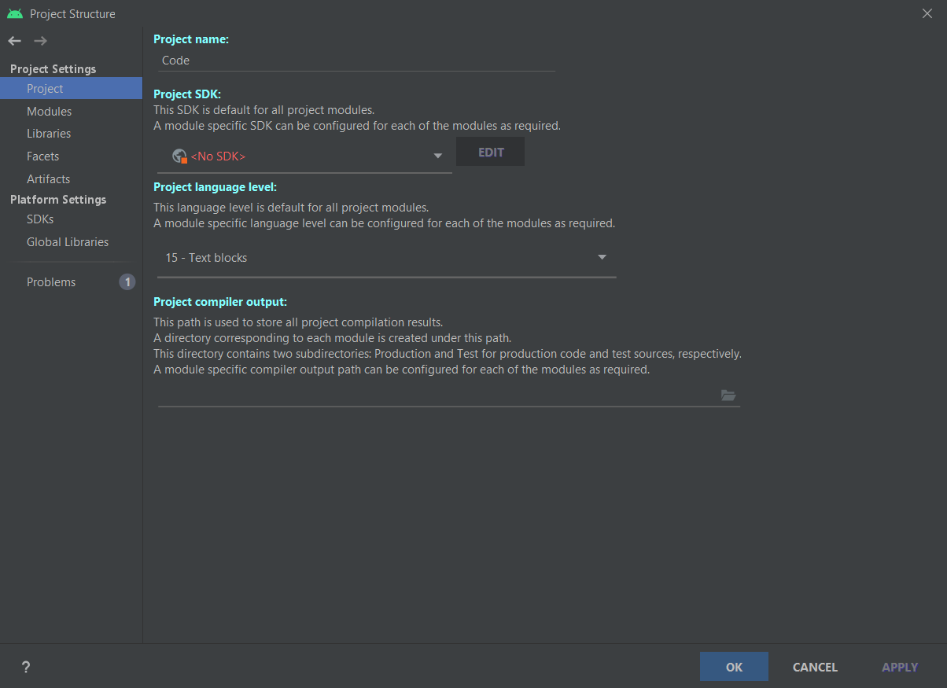
Project structure
File -> project structure
You can find project settings:
Name
Modules: your application modules
Libraries: where you can manage jar dependencies
Platform settings:
SDKs: manage installed JDK and SDK

Slide 7
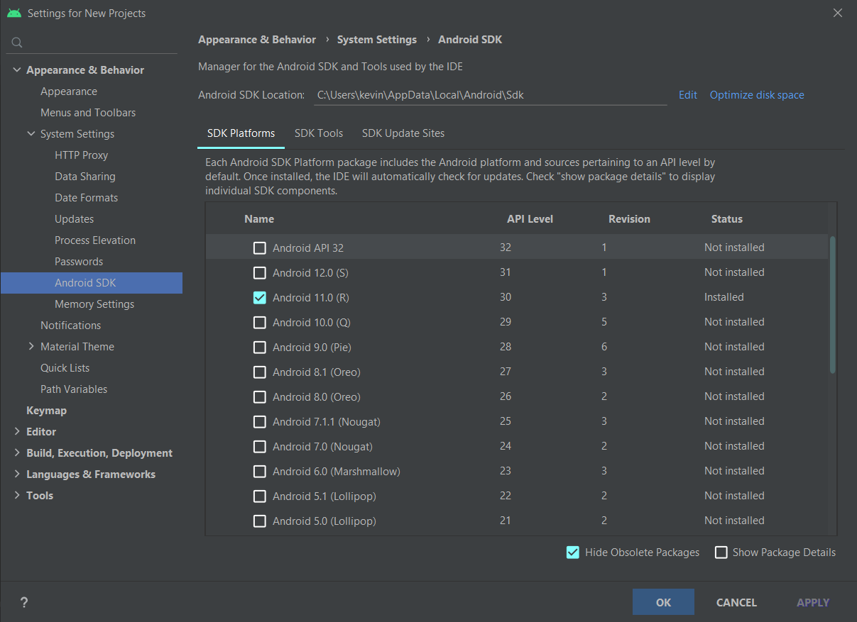
SDK Manager
Tools ➔ SDK manager
Manage Additional SDK Components.
SDK Platform: you can install SDK version and related API
SDK tools: you can see available update and new tools

Slide 8
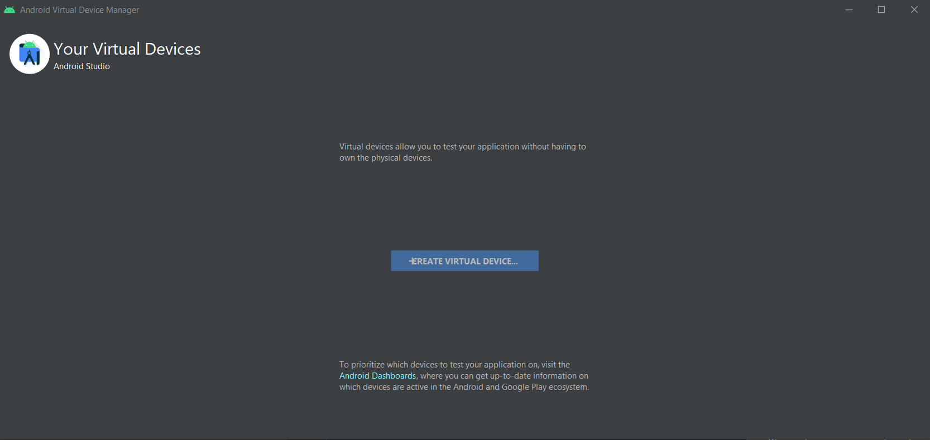
AVD Manager
In Android Studio you can create a AVD (Android Virtual Device) where you can install and run your application.
AVD Manager is the tool that help you to create and manage your AVD.

Slide 9
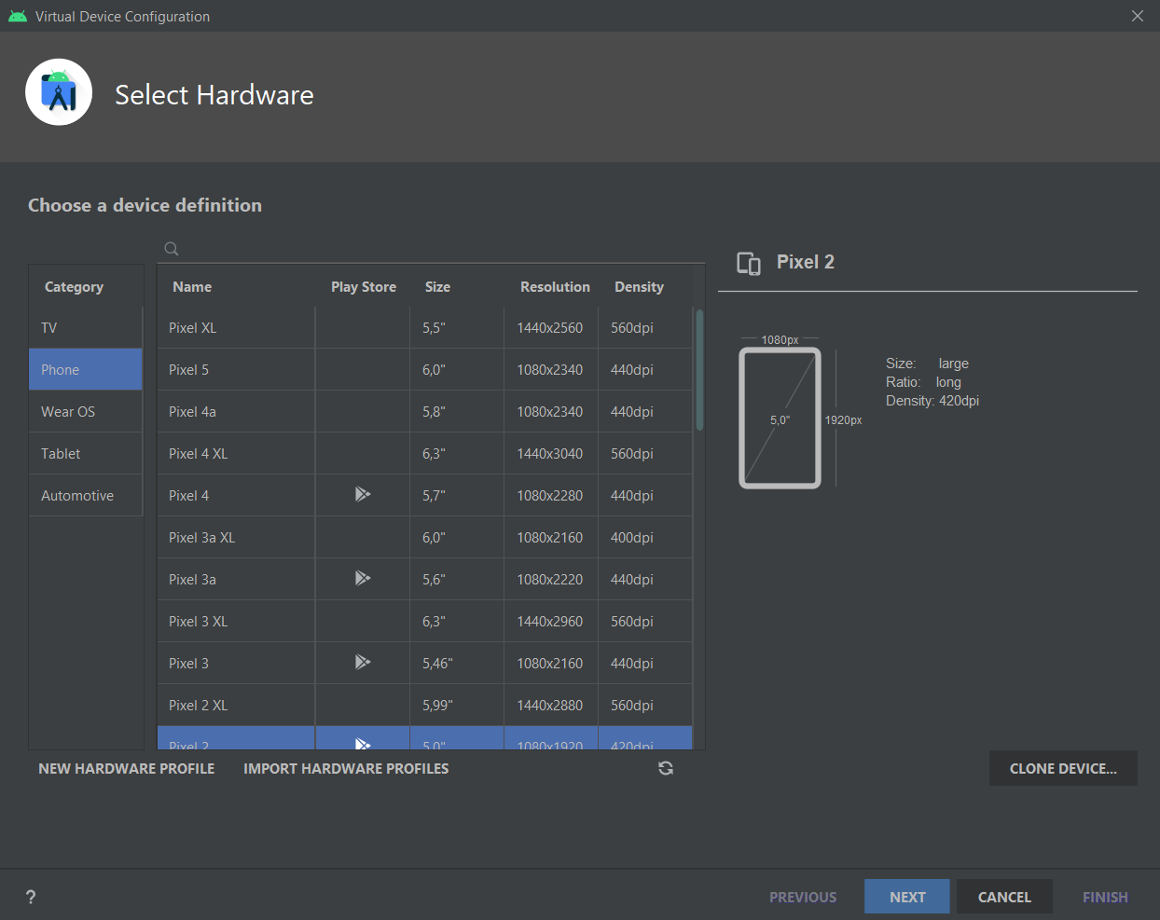
AVD Initialization
You can choose
Type of AVD (Wear, Smarthphone, Tablet, Tv and Automotive)
Specific AVD (e.g. from Google devices list) (is better choose Play Store integrated AVD)

Slide 10
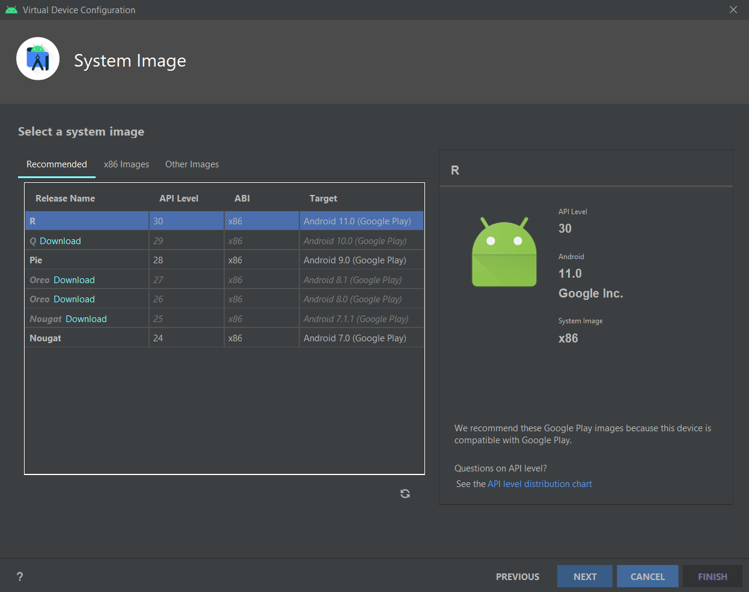
AVD Initialization
API Level (with related Android OS version)

Slide 11
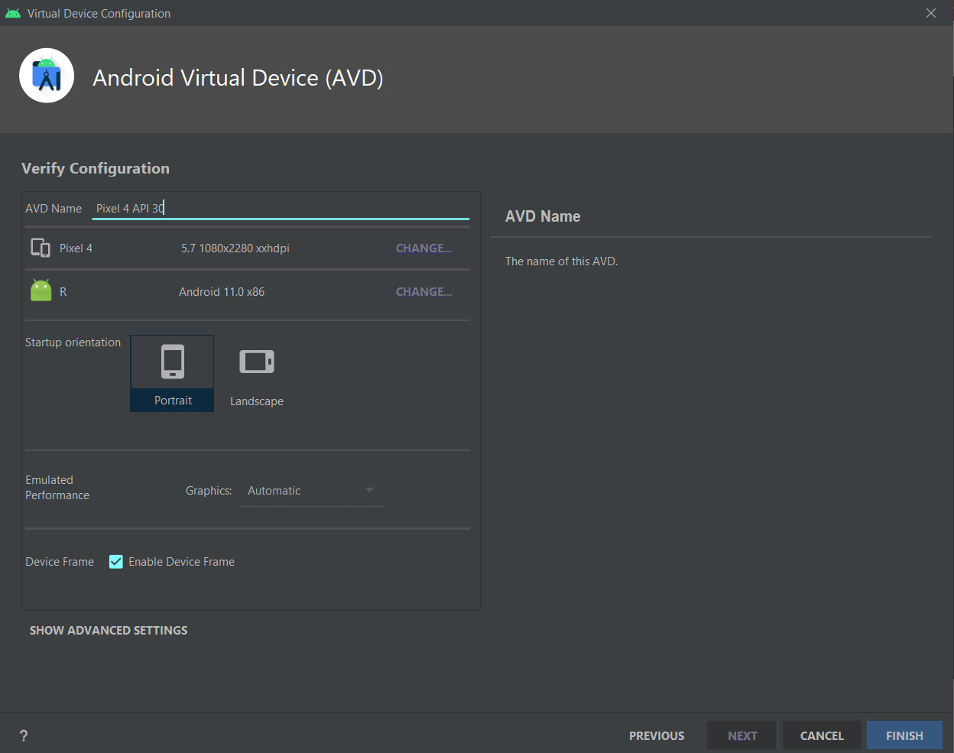
AVD Initialization
Name of AVD
Other technical specifications (display resolution…)

Slide 12
Run and Debug
Run an application means:
Compiles source code to bytecode
Coverts bytecode to Android executable (.dex)
Packages the executable and project’s resources and manifest in Android package (.apk)
Deploys your APK in target device and installs it
Starts application

Slide 13
Run/Debug in real device
Android Studio offers the possibility to install your application and run it in a real Android device
Activate ADB (Android Debug Bridge) on target device (only on Android 6.0 or higher)
Settings ➔ About Phone/Tablet ➔ Software Information
Tap on Build number field seven times (a message appears indicating that developer mode has been enabled)
Go to Settings page and now appears Developer options
Switch on USB debugging option
Connect to PC with USB, device will appear in Android Studio devices list

Slide 14
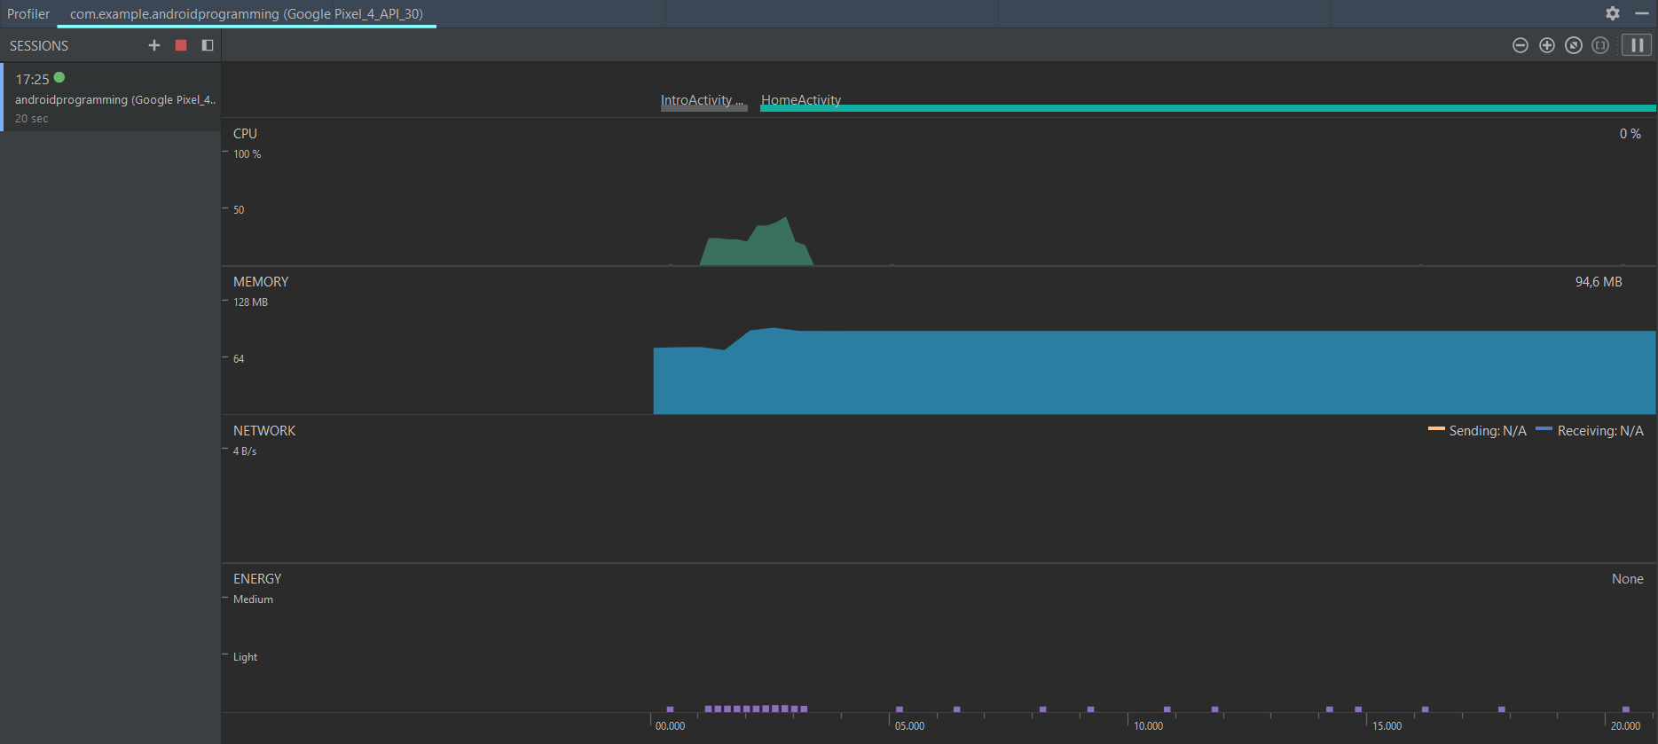
Profiler
You can control system status and hardware work during your application execution:
CPU
Memory
Network
Energy
https://developer.android.com/studio/profile/android-profiler

Slide 15
Tool Window Bar
Tool window bar contains the buttons that allow you to expand or collapse individual tool windows.
On right edge:
Project: show project’s directories
Git tools
Resource manager: show available resources with preview
Structure: open project structure’s window
Build variants
On left edge:
Device file explorer: show device storage
Gradle: show project’s dependencies
On lower edge:
TODO: find TODO elements in your code
Problems: show problem, warning and errors
Terminal: open a terminal of your pc
Build: open build’s window (where you can see build’s log)
Logcat: displays system messages, such as when a garbage collection occurs, and messages that you added to your app with the Log class
Profiler
Run
App inspector: inspect database and background task of running process

Slide 16
Device file explorer
You can also explore storage device
If you use AVD, storage is a directory in your PC
If you use Real device is the real file system
To see your app directory in storage
File explorer -> Data -> Data -> your app package name (e.g. com.example.MyApplication)

Slide 17
Gradle
Gradle is an open-source and general-purpose build automation tool that is designed to be flexible enough to build almost any type of software.
Is based on Groovy or Kotlin scripts
Run on JVM (to use it you must install JDK)
Gradle manage your android project build, dependencies, versions, resources…
https://developer.android.com/studio/build

Slide 18
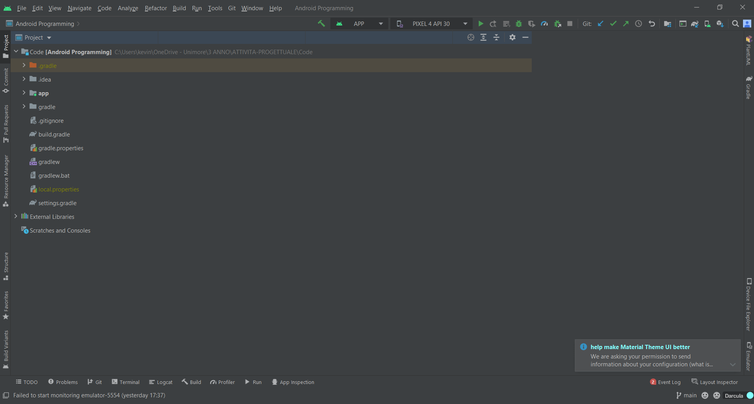
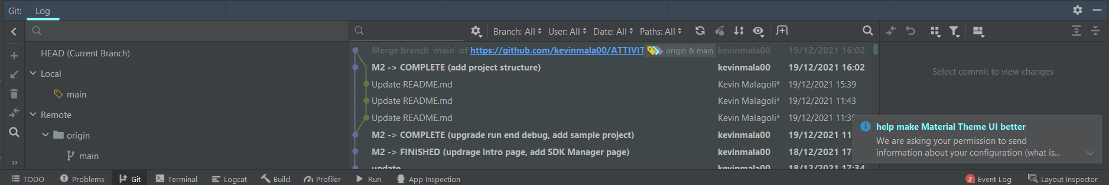
Git tools
You can find git tools in:
Toolbar: allow you to make pull, commit and push quickly
Menubar: you can find a list of all git commands
Tool Window Bar: you can find diagram of all actions in git repository

Slide 19
Visual layout editor
Android Studio offers 3 mode to manipulate graphic element (Layout, Drawable, ecc.), you can choose when you open an xml file
Code mode: use only xml
Split mode: use xml and graphic tool
Design mode: use only drag and drop graphic tool
https://developer.android.com/studio/write/layout-editor

Slide 20
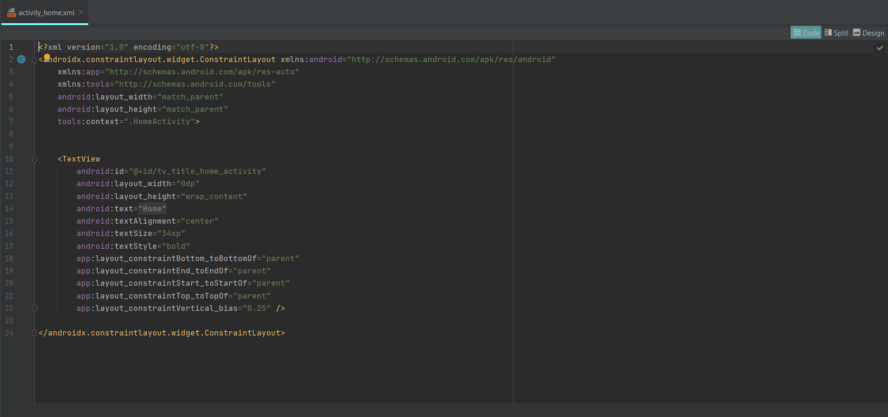
Code Mode

Slide 21
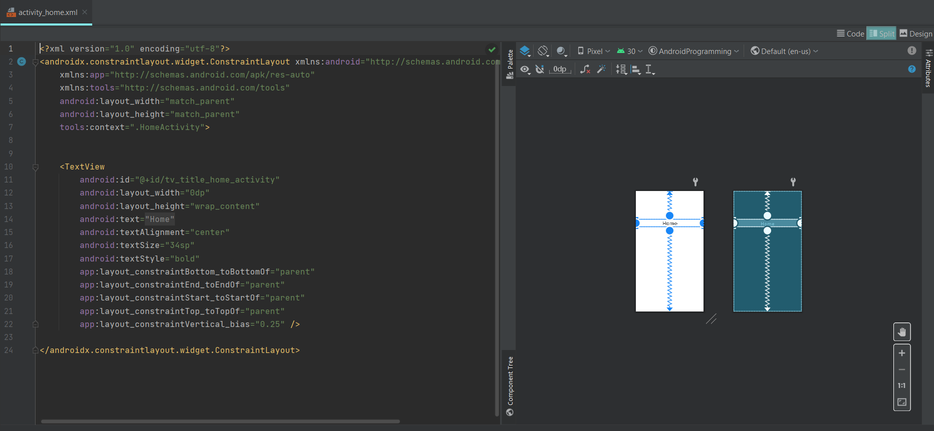
Split Mode

Slide 22
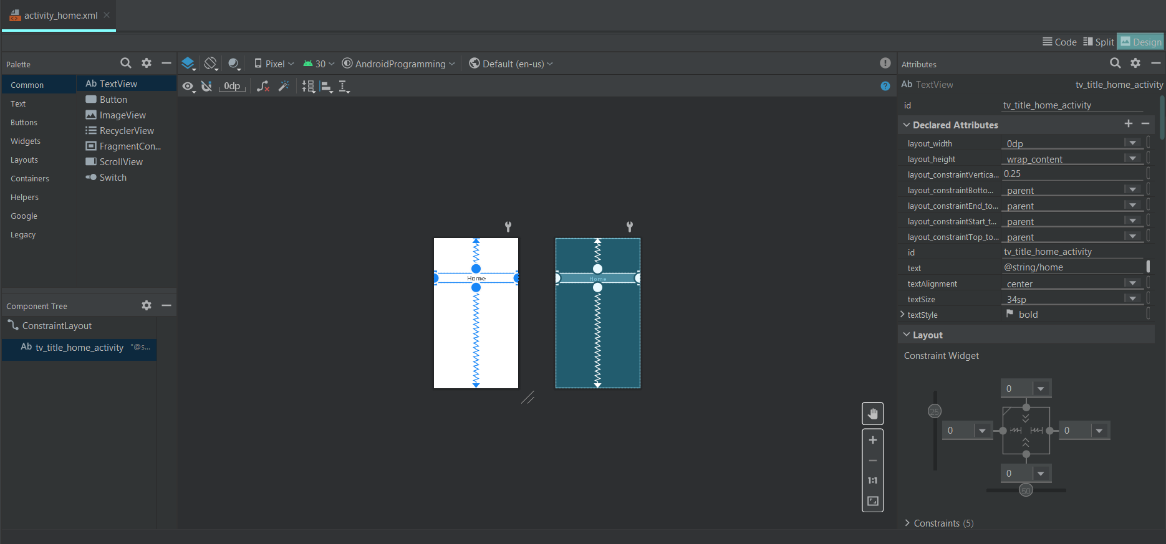
Design Mode

Slide 23
Other tools
SQLite3: From a remote shell to your device or from your host machine, you can use the sqlite3 command-line program to manage SQLite databases created by Android applications. https://developer.android.com/studio/command-line/sqlite3

Slide 24
Project creation

Slide 25
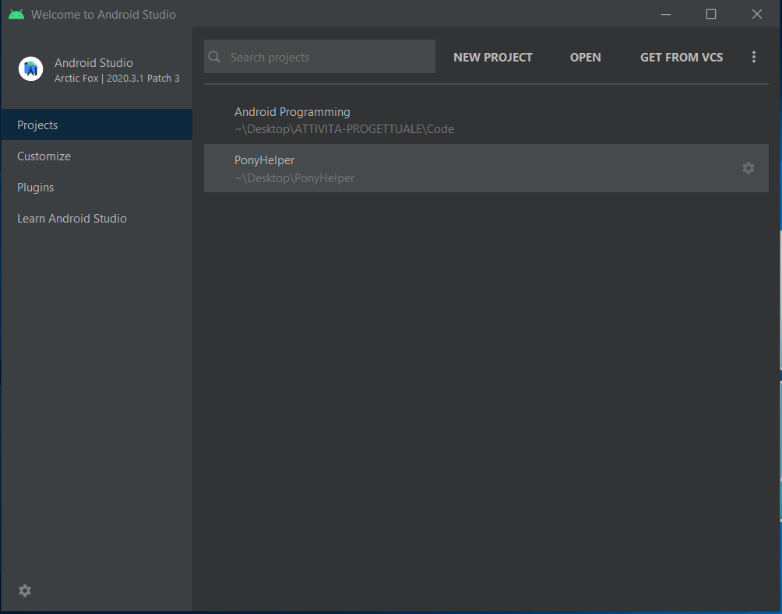
Project creation
Android Studio offers you different way to start projects:
New project: you can start an empty project
Open project: you can open existing project
Import from VCS: you can import project from VCS (Version Control System) thank to GitHub plugins
Open sample project

Slide 26
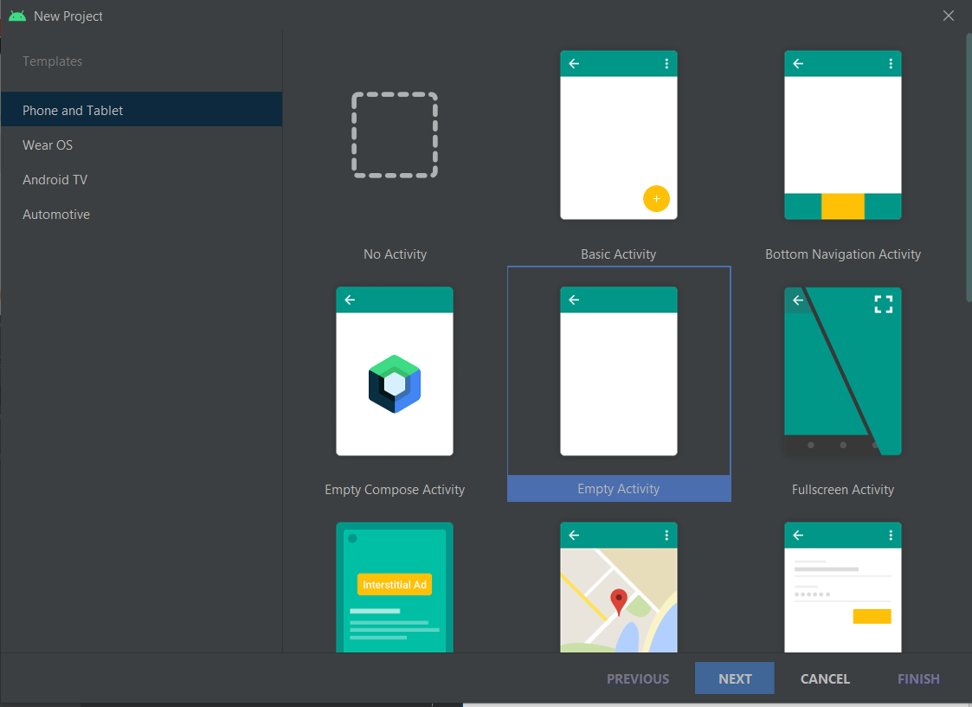
New project
Android Project Wizard helps you to create empty project
You must choose first Activity type

Slide 27
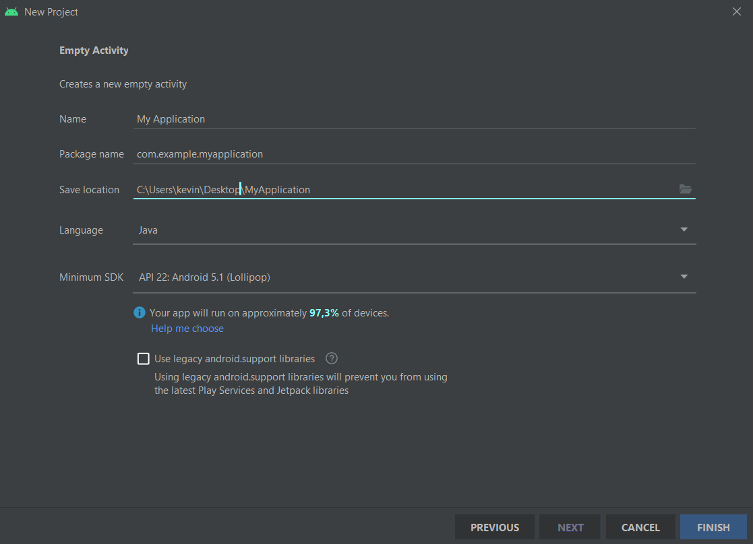
New project (2)
Configure application properties:
Application name
Package name and location
Application programming language (Java, Kotlin)
API and SDK target version

Slide 28
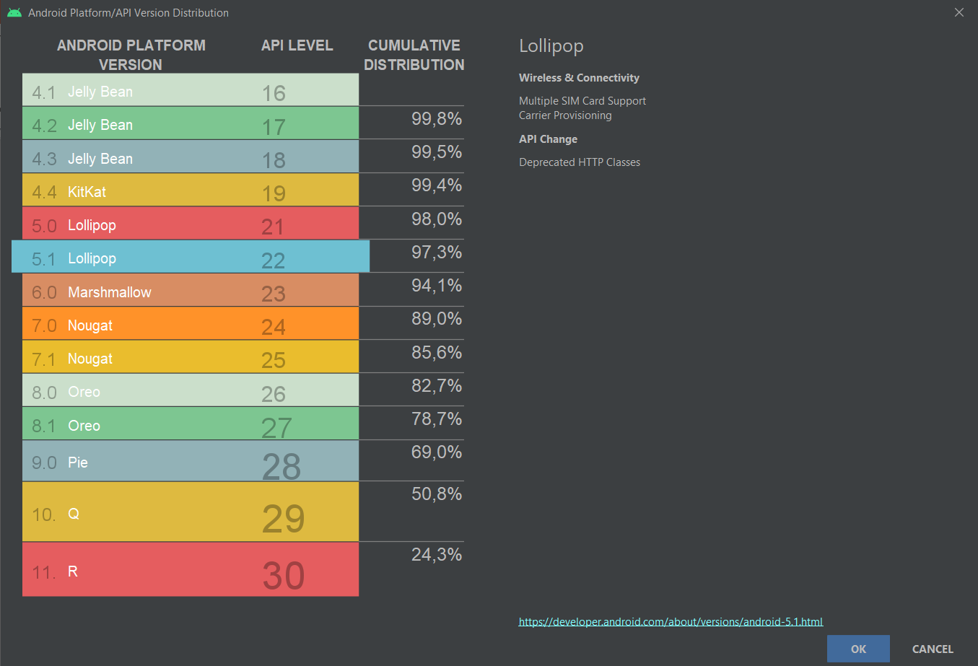
New project (3)
Android studio helps you to choose perfect target Android API for your application, it shows related distibution

Slide 29
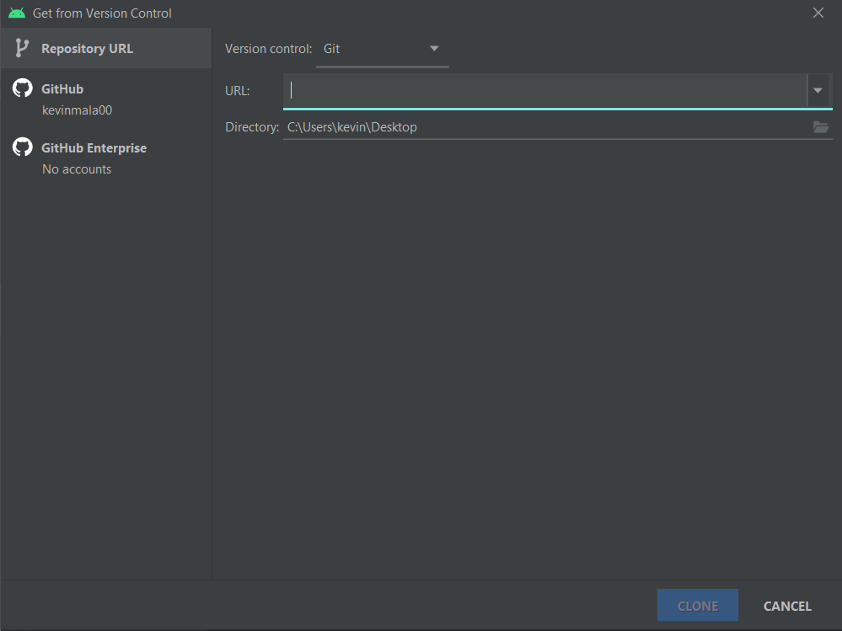
Import from VCS
Android Studio supports a variety of version control systems (VCS’s), including Git, GitHub, CVS, Mercurial, Subversion, and Google Cloud Source Repositories.

Slide 30
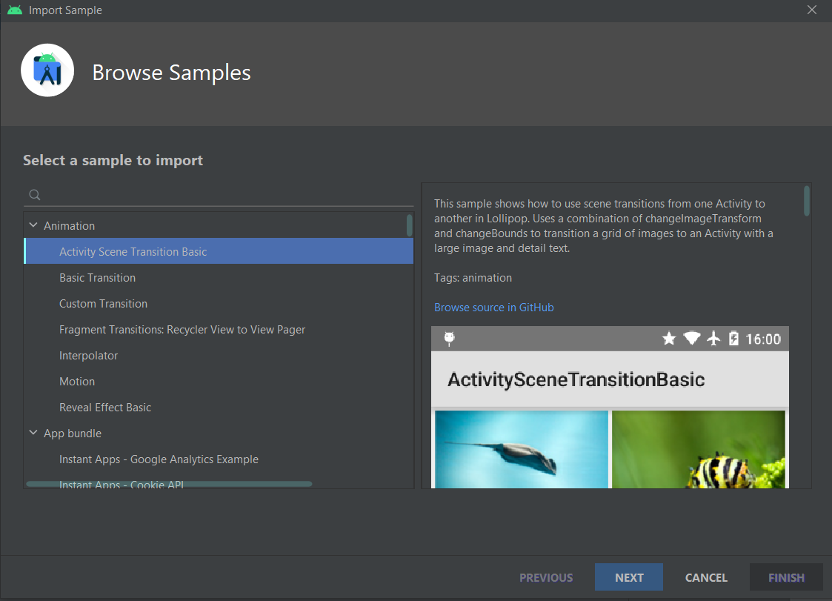
Open sample project
File ➔ new ➔ import sample
Android studio offers the opportunity to import sample project
All sample code in Android Studio are available at https://github.com/googlesamples/

Slide 31
Project structure

Slide 32
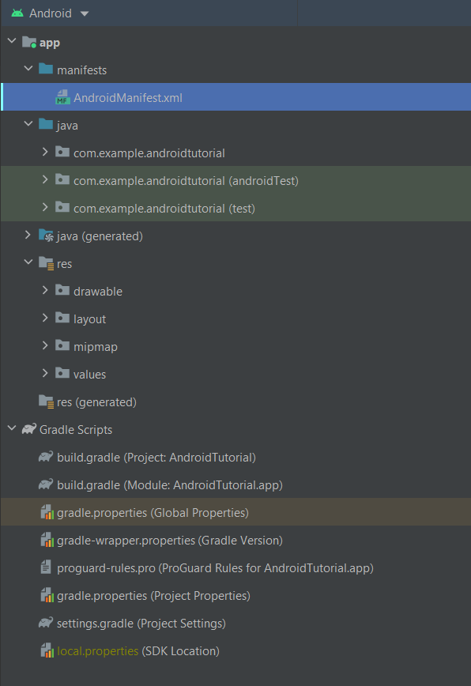
Project structure
The structure of project created by Gradle for you contains:
Manifest: contains AndroidManifest.xml file
Java folder: conteins java code and test
Res folder: contains resources that you can use in your app
Gradle scripts: contains directives for Gradle, module file contains app properties and dependencies

Slide 33
App resources
Android app contains resources separated from the source code, you can define with XML:
Drawable (image file .png ecc…, audio files, and other graphic components)
Layouts: files that define a user interface layout.
Animations
Menus
Mipmap: Drawable files for different launcher icon densities.
Styles: defines the format and look for a UI.
Colors: list of exadecimal code of colors
Strings
Font
Xml: generic xml files
https://developer.android.com/guide/topics/resources/providing-resources

Slide 34
How to access resources?
Each resource have a unique Id, you must use it in java or xml files to acess to resources
In XML files:
@element_type/element_id
e.g.: android:text=‘’@string/app_name’’
In java files:
R.id.element_id
e.g.: textView.setText(R.id.app_name);

Slide 35
XML’s pills
Commenti
<!-- commento -->
Value is assigned to respective tag. Nested tag are allowed (e.g. tag_container).
Tag are unique and represent the id of binded to a value
<tag_container>
<tag1> value </tag1>
<tag2> value </tag2>
</tag_container>

Slide 36
Layout
Layout files describe the architecture of UI.
Contains:
ViewGroup: A container for other View elements. (LinearLayout, ConstraintLayout …)
View: An individual UI component (Button, TextView…)
Each UI elements has attributes like:
unique id.
Dimension
Position in the layout
You can include layout into another one using the id and the directive <include>
Sintassi generica:
<?xml version="1.0" encoding="utf-8"?> <ViewGroup xmlns:android="http://schemas.android.com/apk/res/android" android:id="@[+][package:]id/resource_name" android:layout_height=["dimension" | "match_parent" | "wrap_content"] android:layout_width=["dimension" | "match_parent" | "wrap_content"] [ViewGroup-specific attributes] >
<View android:id="@[+][package:]id/resource_name" android:layout_height=["dimension" | "match_parent" | "wrap_content"] android:layout_width=["dimension" | "match_parent" | "wrap_content"] [View-specific attributes] > </View> <ViewGroup > <View /> </ViewGroup> <include layout="@layout/layout_resource"/> </ViewGroup>

Slide 37
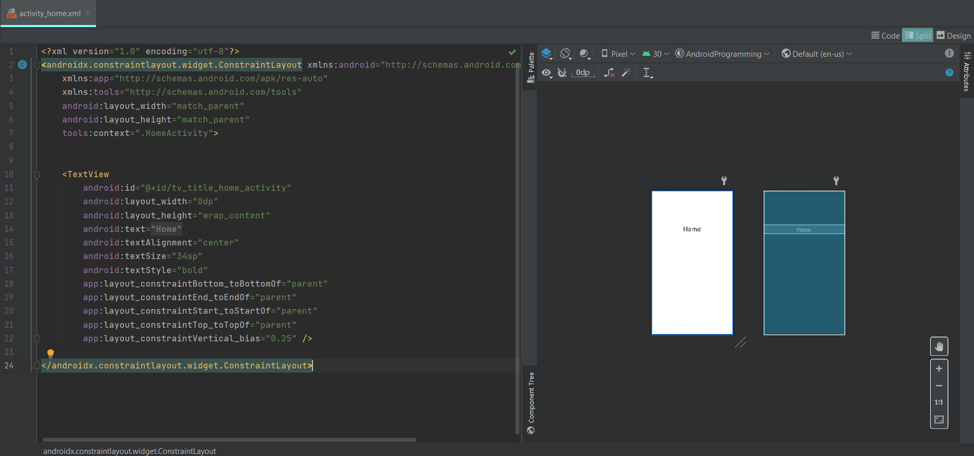
Layout example

Slide 38
Strings and Colors
String is represent by name and value.
You can alse define string array
Colors is represent by a name and exadecimal code
<resources> <string name="app_name">AndroidTutorial</string> <string-array name="week_day"> <item>Monday</item> <item>Tuesday</item> <item>Wednesday</item> <item>Thursday</item> <item>Friday</item> <item>Saturday</item> <item>Sunday</item> </string-array> </resources>
<?xml version="1.0" encoding="utf-8"?> <resources> <color name="purple_200">#FFBB86FC</color> <color name="purple_500">#FF6200EE</color> <color name="purple_700">#FF3700B3</color> <color name="teal_200">#FF03DAC5</color> <color name="teal_700">#FF018786</color> <color name="black">#FF000000</color> <color name="white">#FFFFFFFF</color> </resources>

Slide 39
Style
Styles file contains all available styles that you can use in application.
A style resource defines the format and look for a UI. It can be applied to a single view or to an entire activity or application in manifest file
Style has required attributes:
Name
Parent: define style hierarchy
Is possible customize a style by adding extra attributes
<resources xmlns:tools="http://schemas.android.com/tools"> <!-- Base application theme. --> <style name="Theme.AndroidProgramming" parent="Theme.MaterialComponents.DayNight.DarkActionBar"> <!-- Primary brand color. --> <item name="colorPrimary">@color/purple_500</item> <item name="colorPrimaryVariant">@color/purple_700</item> <item name="colorOnPrimary">@color/white</item> <!-- Secondary brand color. --> <item name="colorSecondary">@color/teal_200</item> <item name="colorSecondaryVariant">@color/teal_700</item> <item name="colorOnSecondary">@color/black</item> <!-- Status bar color. --> <item name="android:statusBarColor" tools:targetApi="l">?attr/colorPrimaryVariant</item> <!-- Customize your theme here. --> </style> </resources>

Slide 40
AndroidManifest.xml
Describes essential information about your app.
Contains:
App's package name
App’s components (Activities, Services …) each of them must define basic properties (e.g. name of java class)
Permission
Hardware and software the app reqires
https://developer.android.com/guide/topics/manifest/manifest-intro
<?xml version="1.0" encoding="utf-8"?> <manifest xmlns:android="http://schemas.android.com/apk/res/android" package="com.example.androidtutorial"> <application android:allowBackup="true" android:fullBackupOnly="true" android:icon="@mipmap/ic_launcher" android:label="@string/app_name" android:roundIcon="@mipmap/ic_launcher_round" android:supportsRtl="true" android:theme="@style/Theme.AndroidTutorial"> <activity android:name=".IntroActivity" android:exported="true"> <intent-filter> <action android:name="android.intent.action.MAIN" /> <category android:name="android.intent.category.LAUNCHER" /> </intent-filter> </activity> </application> </manifest>

Slide 41
Build.gradle (Module: ProjectName.app)
Contains:
App id
App properties:
MinSdk: minumum API’s version that target device must support
versionCode
versionName
App dependencies
plugins { id 'com.android.application' } android { compileSdk 30 defaultConfig { applicationId "com.example.androidprogramming" minSdk 21 targetSdk 30 versionCode 1 versionName "1.0" testInstrumentationRunner "androidx.test.runner.AndroidJUnitRunner" } buildTypes { release { minifyEnabled false proguardFiles getDefaultProguardFile('proguard-android-optimize.txt'), 'proguard-rules.pro' } } compileOptions { sourceCompatibility JavaVersion.VERSION_1_8 targetCompatibility JavaVersion.VERSION_1_8 } } dependencies { implementation 'androidx.appcompat:appcompat:1.3.1' implementation 'com.google.android.material:material:1.4.0' implementation 'androidx.constraintlayout:constraintlayout:2.1.1' testImplementation 'junit:junit:4.+' androidTestImplementation 'androidx.test.ext:junit:1.1.3' androidTestImplementation 'androidx.test.espresso:espresso-core:3.4.0' }

